Slide 1



Reporting on Science and Technology: Readable Jargon
Ashley Powell
The Arizona Daily Star
Mentor: Sarah Gassen
Editors: David Wichner and Norma Coile
April 12, 2014

Slide 2
Overview
Technology or science stories involve terms like: composite materials, NSF, water-soluble, SBIRP and SBTTP, phase-one projects, 5G, cyber security, ACI, electromagnetics, electromagnetic waves and spectrum.
Reported on issues that dealt with this kind of jargon.

Slide 3
Problem Statement
Scientists and tech gurus have their own language. (NetLingo= online dictionary for technology terms).
Science and tech reporters have break down these terms so the general public can understand the story.

Slide 4
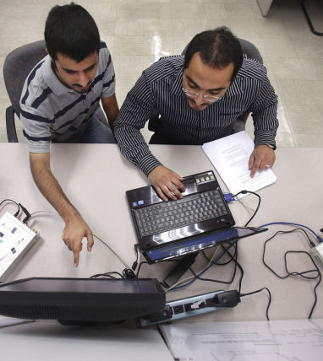
“UA leads research on next-generation wireless”
“However, Bose said, there is no more room for wireless waves to travel. The usable spectrum is licensed out and used up, creating a problem Bose likens to a city with too many cars and too few roadways.”
Photo by Mike Christy/ Arizona Daily Star

Slide 5
Methods
Did back grounding before the interview→ understanding what kinds of questions to ask and what points were confusing and needed further follow up
Asked source lots of questions regarding certain terminology.
Sources gave metaphors or real world examples in order to explain certain issues within the story.

Slide 6
End Results
Metaphors/ real-world examples are most effective
Now understand general terms or terms often used in the science and tech community
Sources will take a step back and break things down when asked…sometimes they forget they aren’t speaking with a colleague
Editors with experience in science or tech reporting will help with questions about the science and tech community
Online resources help with further explanation of various abbreviations or terms

Slide 7
Takeaways
Science and technology-related stories have a high public interest.
The language within the science and technology community is difficult for the average reader to understand.
As reporters, we need to utilize online resources, ask our sources an enormous amount of questions, report in detail, use metaphors and write in the most simplistic terms.

Slide 8
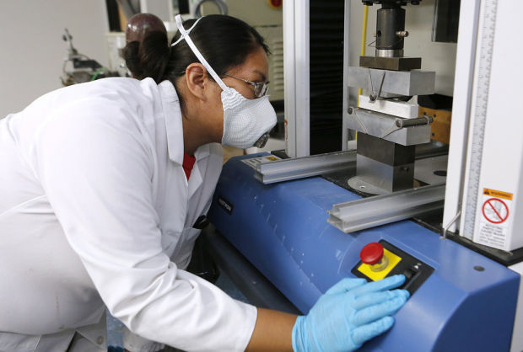
Other Stories
“Tucson techie entrepreneurs drop an anchor at Pirate Mansion.”
“‘End of life’ for Windows XP could haunt users.”
“UA training cyber security experts for FBI, CIA and NSA.”
“O’odham areospace firm sharpens its cutting edge.”
Photo by Benji Sanders/ Arizona Daily Star

Slide 9
Acknowledgements and Special Thanks
    The AZ/NASA Space Grant Program
      Susan Brew
      Barron Orr
    The Arizona Daily Star
      Norma Coile
      Dave Wichner
    The University of Arizona
      Sarah Gassen

